Slide 1
Quick Sort

Slide 2
Quick Sort
Fastest known sorting algorithm in practice
Average case: O(N log N)
Worst case: O(N²)
  But the worst case can be made exponentially unlikely.
Another divide-and-conquer recursive algorithm, like merge sort.

Slide 3
Quick Sort: Main Idea
If the number of elements in S is 0 or 1, then return (base case).
Pick any element v in S (called the pivot).
Partition the elements in S except v into two disjoint groups:
  S₁ = {x ∈ S – {v} | x ≤ v}
  S₂ = {x ∈ S – {v} | x ≥ v}
Return {QuickSort(S₁) + v + QuickSort(S₂)}

Slide 4
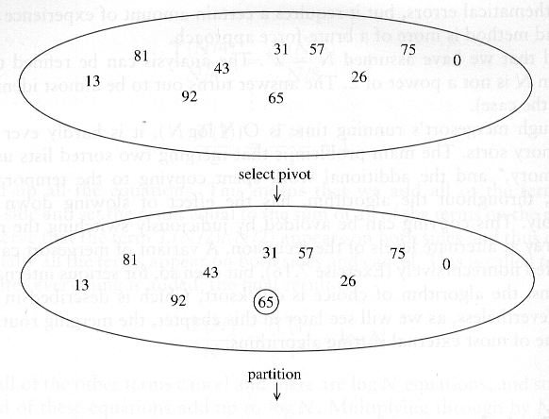
Quick Sort: Example

Slide 5
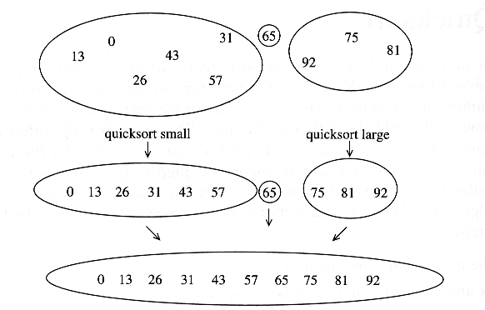
Example of Quick Sort...

Slide 6
Partitioning Strategy
For now, assume that pivot = A[(left+right)/2].
We want to partition array A[left .. right].
First, get the pivot element out of the way by swapping it with the last element (swap pivot and A[right]).
Let i start at the first element and j start at the next-to-last element (i = left, j = right – 1)
swap
5
7
4
6
3
12
19
5
7
4
19
3
12
6
pivot
i
j

Slide 7
Partitioning Strategy
Want to have
  A[k] ≤ pivot, for k < i
  A[k] ≥ pivot, for k > j
When i < j
  Move i right, skipping over elements smaller than the pivot
  Move j left, skipping over elements greater than the pivot
  When both i and j have stopped
    A[i] ≥ pivot
    A[j] ≤ pivot ⇒ A[i] and A[j] should now be swapped
≤ pivot
≥ pivot
i
j
5
7
4
19
3
12
6
5
7
4
19
3
12
6
i
j
i
j

Slide 8
Partitioning Strategy (2)
When i and j have stopped and i is to the left of j (thus legal)
  Swap A[i] and A[j]
    The large element is pushed to the right and the small element is pushed to the left
  After swapping
    A[i] ≤ pivot
    A[j] ≥ pivot
  Repeat the process until i and j cross
swap
5
7
4
19
3
12
6
5
3
4
19
7
12
6
i
j
i
j

Slide 9
Partitioning Strategy (3)
5
3
4
19
7
12
6
When i and j have crossed
  swap A[i] and pivot
Result:
  A[k] ≤ pivot, for k < i
  A[k] ≥ pivot, for k > i
i
j
5
3
4
19
7
12
6
j
i
swap A[i] and pivot
5
3
4
6
7
12
19
Break!
j
i

Slide 10
Picking the Pivot
There are several ways to pick a pivot.
Objective: Choose a pivot so that we will get 2 partitions of (almost) equal size.

Slide 11
Picking the Pivot (2)
Use the first element as pivot
  if the input is random, ok.
  if the input is presorted (or in reverse order)
    all the elements go into S₂ (or S₁).
    this happens consistently throughout the recursive calls.
    results in O(N²) behavior (we analyze this case later).
Choose the pivot randomly
  generally safe,
  but random number generation can be expensive and does not reduce the running time of the algorithm.

Slide 12
Picking the Pivot (3)
Use the median of the array (ideal pivot)
  The ⎡N/2⎤ th largest element
  Partitioning always cuts the array into roughly half
  An optimal quick sort (O(N log N))
  However, hard to find the exact median
Median-of-three partitioning
  eliminates the bad case for sorted input.
  reduces the number of comparisons by 14%.

Slide 13
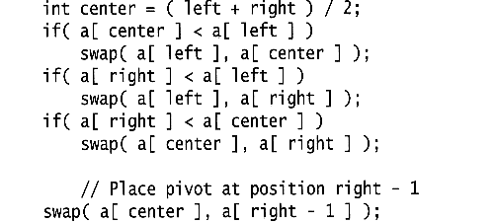
Median of Three Method
Compare just three elements: the leftmost, rightmost and center
  Swap these elements if necessary so that
    A[left] = Smallest
    A[right] = Largest
    A[center] = Median of three
  Pick A[center] as the pivot.
  Swap A[center] and A[right – 1] so that the pivot is at the second last position (why?)

Slide 14
Median of Three: Example
2
5
6
4
13
3
12
19
6
A[left] = 2, A[center] = 13, A[right] = 6
2
5
6
4
6
3
12
19
13
Swap A[center] and A[right]
2
5
6
4
6
3
12
19
13
Choose A[center] as pivot
pivot
2
5
6
4
19
3
12
6
13
Swap pivot and A[right – 1]
pivot
We only need to partition A[ left + 1, …, right – 2 ]. Why?

Slide 15
Quick Sort Summary
Recursive case: QuickSort( a, left, right )
  pivot = median3( a, left, right );
  Partition a[left … right] into a[left … i-1], i, a[i+1 … right];
  QuickSort( a, left, i-1 );
  QuickSort( a, i+1, right );
Base case: when do we stop the recursion?
  In theory, when left >= right.
  In practice, …

Slide 16
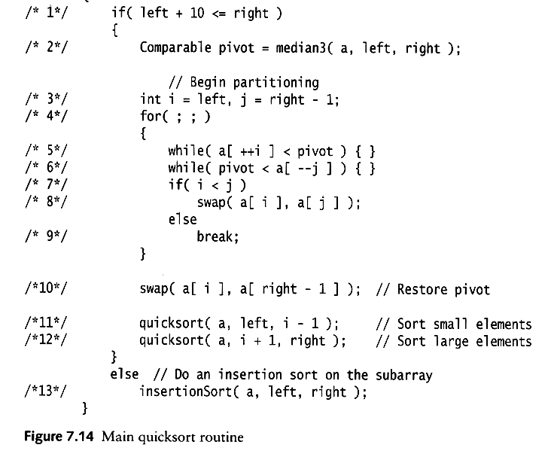
Quick Sort: Pseudo-code
Choose pivot
Partitioning
Recursion
For small arrays

Slide 17
Partitioning Part
The partitioning code we just saw works only if pivot is picked as median-of-three.
  A[left] ≤ pivot and A[right] ≥ pivot
  Need to partition only
  A[left + 1, …, right – 2]
j will not run past the beginning
  because A[left] ≤ pivot
i will not run past the end
  because A[right-1] = pivot

Slide 18
Quick Sort Faster Than Merge Sort
Both quick sort and merge sort take O(N log N) in the average case.
But quick sort is faster in the average case:
  The inner loop consists of an increment/decrement (by 1, which is fast), a test and a jump.
  There is no extra juggling as in merge sort.
inner loop

Slide 19
Analysis
Assumptions:
A random pivot (no median-of-three partitioning)
No cutoff for small arrays ( to make it simple)
If the number of elements in S is 0 or 1, then return (base case).
Pick an element v in S (called the pivot).
Partition the elements in S except v into two disjoint groups:
  S₁ = {x ∈ S – {v} | x ≤ v}
  S₂ = {x ∈ S – {v} | x ≥ v}
Return {QuickSort(S₁) + v + QuickSort(S₂)}

Slide 20
Analysis (2)
Running time
  pivot selection: constant time, i.e. O(1)
  partitioning: linear time, i.e. O(N)
  running time of the two recursive calls
T(N)= T(i) + T(N – i – 1) + cN
  i: number of elements in S1
  c is a constant

Slide 21
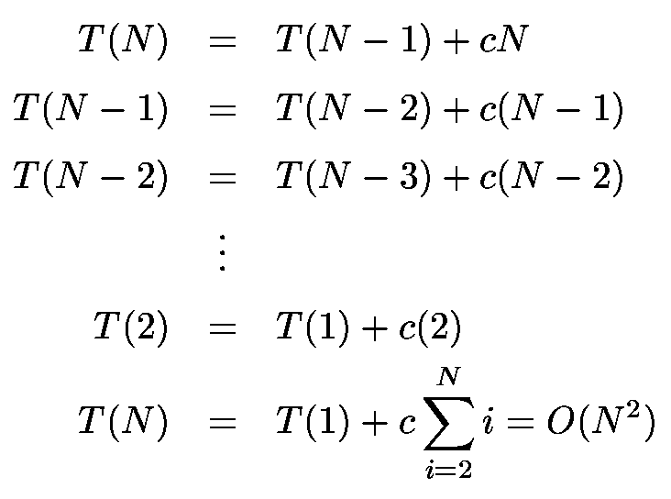
Worst-Case Scenario
What will be the worst case?
  The pivot is the smallest element, all the time
  Partition is always unbalanced

Slide 22
Best-Case Scenario
What will be the best case?
  Partition is perfectly balanced.
  Pivot is always in the middle (median of the array).
T(N) = T(N/2) + T(N/2) + cN = 2T(N/2) + cN
This recurrence is similar to the merge sort recurrence.
The result is O(NlogN).

Slide 23
Average-Case Analysis
Assume that each of the sizes for S₁ is equally likely ⇒ has probability 1/N.
This assumption is valid for the pivoting and partitioning strategy just discussed (but may not be for some others),
On average, the running time is O(N log N).
Proof: pp 272–273, Data Structures and Algorithm Analysis by M. A. Weiss, 2nd edition

Slide 24
Can we do better?
Linear sorting algorithms
  Counting Sort
  Radix Sort
  Bucket sort
Make certain assumptions about the data
Linear sorts are NOT “comparison sorts”

Slide 25

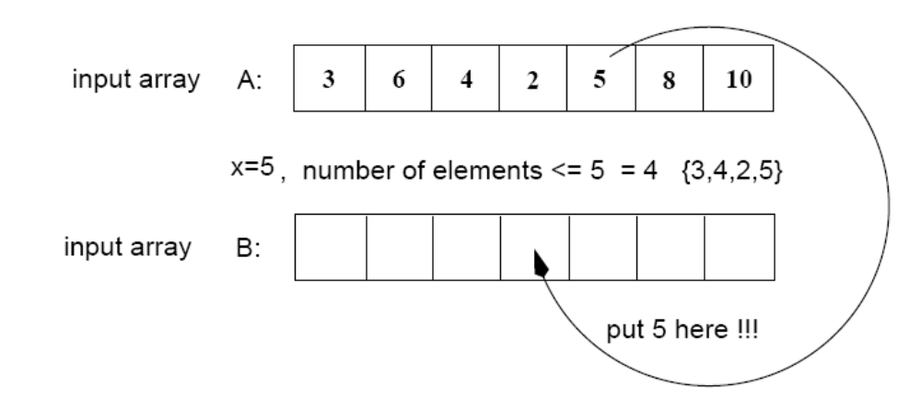
Counting Sort
Assumptions:
  n integers which are in the range [0 ... r]
  r is in the order of n, that is, r=O(n)
Idea:
  For each element x, find the number of elements x
  Place x into its correct position in the output array
output array

Slide 26
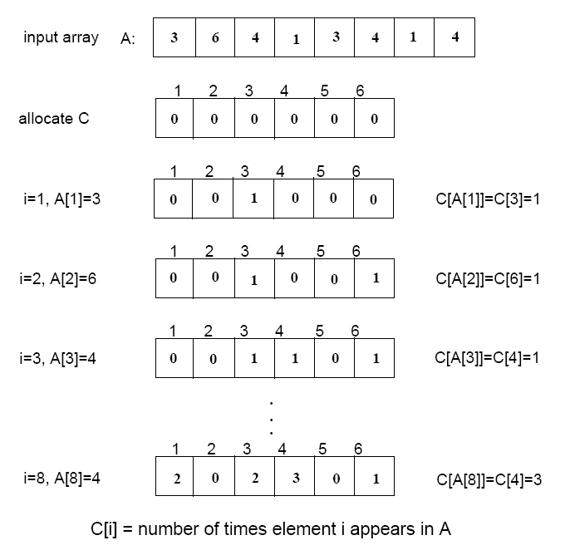
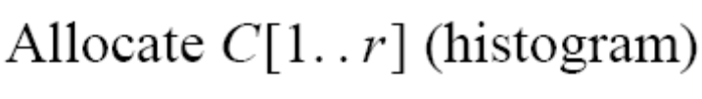

Step 1
(i.e., frequencies)
(r=6)

Slide 27
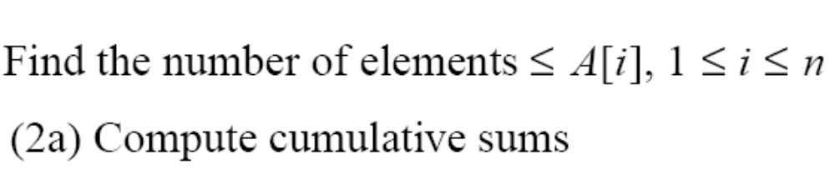
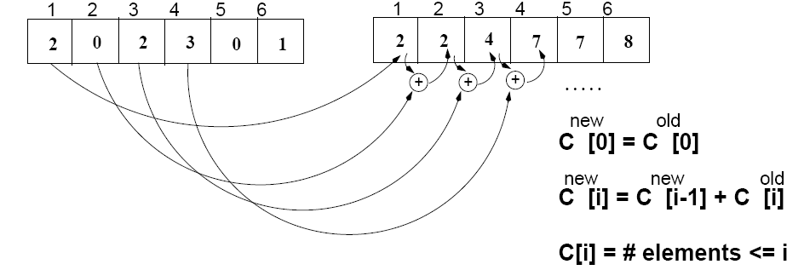
Step 2
C
(frequencies)
C^{new}
(cumulative sums)

Slide 28
Algorithm
Start from the last element of A
Place A[i] at its correct place in the output array
Decrease C[A[i]] by one
1
2
3
4
5
6
7
8
A
2
5
3
0
2
3
0
3
0
1
2
3
4
5
C^{new}
2
2
4
7
7
8

Slide 29
Example
1
2
3
4
5
6
7
8
0
1
2
3
4
5
A
2
5
3
0
2
3
0
3
C^{new}
2
2
4
7
7
8
1
2
3
4
5
6
7
8
1
2
3
4
5
6
7
8
B
3
B
0
3
0
1
2
3
4
5
0
1
2
3
4
5
C^{new}
C^{new}
1
2
4
6
7
8
2
2
4
6
7
8
1
2
3
4
5
6
7
8
1
2
3
4
5
6
7
8
B
0
3
3
B
0
2
3
3
0
1
2
3
4
5
0
1
2
3
4
5
C^{new}
C^{new}
1
2
3
5
7
8
1
2
4
5
7
8

Slide 30
Example (cont.)
1
2
3
4
5
6
7
8
A
2
5
3
0
2
3
0
3
1
2
3
4
5
6
7
8
1
2
3
4
5
6
7
8
B
0
0
2
3
3
B
0
0
2
3
3
3
5
0
1
2
3
4
5
0
1
2
3
4
5
C
0
2
3
5
7
8
C
0
2
3
4
7
7
1
2
3
4
5
6
7
8
1
2
3
4
5
6
7
8
B
0
0
2
3
3
3
B
0
0
2
2
3
3
3
5
0
1
2
3
4
5
C
0
2
3
4
7
8

Slide 31
COUNTING-SORT
1
j
n
A
  Alg.: COUNTING-SORT(A, B, n, k)
  for i ← 0 to r
  do C[ i ] ← 0
  for j ← 1 to n
  do C[A[ j ]] ← C[A[ j ]] + 1
  C[i] contains the number of elements equal to i
  for i ← 1 to r
  do C[ i ] ← C[ i ] + C[i -1]
  C[i] contains the number of elements ≤ i
  for j ← n downto 1
  do B[C[A[ j ]]] ← A[ j ]
  C[A[ j ]] ← C[A[ j ]] - 1
0
k
C
1
n
B

Slide 32
Analysis of Counting Sort
  Alg.: COUNTING-SORT(A, B, n, k)
  for i ← 0 to r
  do C[ i ] ← 0
  for j ← 1 to n
  do C[A[ j ]] ← C[A[ j ]] + 1
  C[i] contains the number of elements equal to i
  for i ← 1 to r
  do C[ i ] ← C[ i ] + C[i -1]
  C[i] contains the number of elements ≤ i
  for j ← n downto 1
  do B[C[A[ j ]]] ← A[ j ]
  C[A[ j ]] ← C[A[ j ]] - 1
O(r)
O(n)
O(r)
O(n)
Overall time: O(n + r)

Slide 33
Analysis of Counting Sort
Overall time: O(n + r)
In practice we use COUNTING sort when r = O(n)
⇒ running time is O(n)

Slide 34
Radix Sort
Represents keys as d-digit numbers in some base-k
key = x₁x₂...x_{d} where 0≤x_{i}≤k-1
Example: key=15
key₁₀ = 15, d=2, k=10 where 0≤x_{i}≤9
key₂ = 1111, d=4, k=2 where 0≤x_{i}≤1

Slide 35

Radix Sort
Assumptions
  d=O(1) and k =O(n)
Sorting looks at one column at a time
  For a d digit number, sort the least significant digit first
  Continue sorting on the next least significant digit, until all digits have been sorted
  Requires only d passes through the list

Slide 36

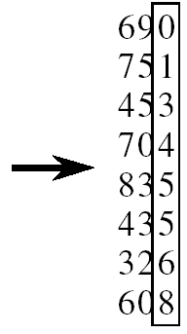
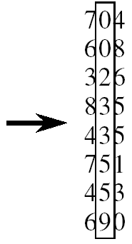
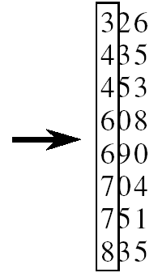
RADIX-SORT
Alg.: RADIX-SORT(A, d)
for i ← 1 to d
do use a stable sort to sort array A on digit i
(stable sort: preserves order of identical elements)

Slide 37
Analysis of Radix Sort
Given n numbers of d digits each, where each digit may take up to k possible values, RADIX-SORT correctly sorts the numbers in O(d(n+k))
  One pass of sorting per digit takes O(n+k) assuming that we use counting sort
  There are d passes (for each digit)

Slide 38
Analysis of Radix Sort
Given n numbers of d digits each, where each digit may take up to k possible values, RADIX-SORT correctly sorts the numbers in O(d(n+k))
  Assuming d=O(1) and k=O(n), running time is O(n)

Slide 39
Bucket Sort
Assumption:
  the input is generated by a random process that distributes elements uniformly over [0, 1)
Idea:
  Divide [0, 1) into k equal-sized buckets (k=Θ(n))
  Distribute the n input values into the buckets
  Sort each bucket (e.g., using quicksort)
  Go through the buckets in order, listing elements in each one
Input: A[1 . . n], where 0 ≤ A[i] < 1 for all i
Output: elements A[i] sorted

Slide 40
Example - Bucket Sort
A
1
.78
.17
.39
.26
.72
.94
.21
.12
.23
.68
B
0
/
2
1
.17
.12 /
3
2
.26
.21
.23 /
4
3
.39 /
5
4
/
Distribute
Into buckets
6
5
/
7
6
.68 /
8
7
.78
.72 /
9
8
/
10
9
.94 /

Slide 41
Example - Bucket Sort
0
/
1
.12
.17 /
2
.21
.23
.26 /
3
.39 /
Sort within each
bucket
4
/
5
/
6
.68 /
7
.72
.78 /
8
/
9
.94 /

Slide 42
Example - Bucket Sort
.12
.17
.21
.23
.26
.39
.68
.72
.78
.94 /
0
/
1
.12
.17 /
2
.21
.23
.26 /
3
.39 /
4
/
5
/
Concatenate the lists from
0 to n – 1 together, in order
6
.68 /
7
.72
.78 /
8
/
9
.94 /

Slide 43
Analysis of Bucket Sort
Alg.: BUCKET-SORT(A, n)
for i ← 1 to n
do insert A[i] into list B[⎣nA[i]⎦]
for i ← 0 to k - 1
do sort list B[i] with quicksort sort
concatenate lists B[0], B[1], . . . , B[n -1] together in order
return the concatenated lists
O(n)
k O(n/k log(n/k))
=O(nlog(n/k)
O(k)
O(n) (if k=Θ(n))

Slide 44
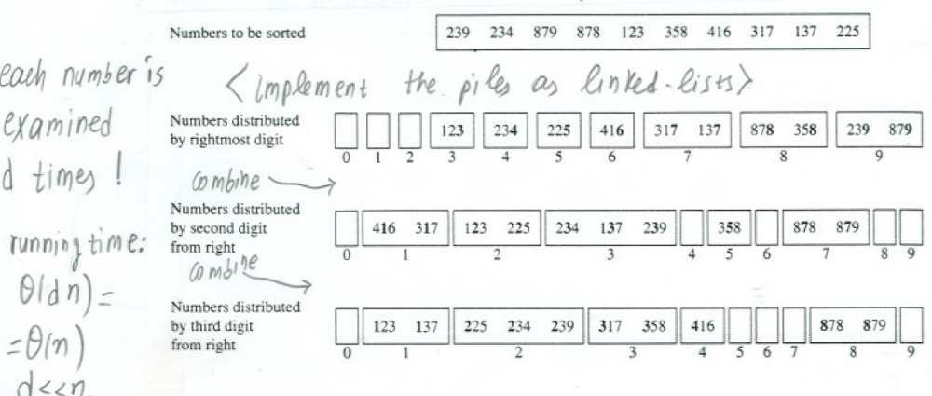
Radix Sort as a Bucket Sort

